Slide 1

Apex Institute of Technology
Department of Computer Science & Engineering
Data Mining and Warehousing
(CSF-334)
Dr Neha Agarwal
E11231
Assistant Professor
CSE(AIT), CU
DISCOVER . LEARN . EMPOWER

Slide 2
Contents to be Covered
Data Integration
Handling Redundancy in Data Integration
Correlation Analysis (Nominal Data)

Slide 3
Data Integration
Data integration:
Combines data from multiple sources into a coherent store
Schema integration: e.g., A.cust-id ≡ B.cust-#
Integrate metadata from different sources
Entity identification problem:
Identify real world entities from multiple data sources, e.g., Bill Clinton = William Clinton
Detecting and resolving data value conflicts
For the same real world entity, attribute values from different sources are different
Possible reasons: different representations, different scales, e.g., metric vs. British units
3

Slide 4
Handling Redundancy in Data Integration
Redundant data occur often when integration of multiple databases
Object identification: The same attribute or object may have different names in different databases
Derivable data: One attribute may be a “derived” attribute in another table, e.g., annual revenue
Redundant attributes may be able to be detected by correlation analysis and covariance analysis
Careful integration of the data from multiple sources may help reduce/avoid redundancies and inconsistencies and improve mining speed and quality
4

Slide 5
Correlation Analysis (Nominal Data)
Χ² (chi-square) test
The larger the Χ² value, the more likely the variables are related
The cells that contribute the most to the Χ² value are those whose actual count is very different from the expected count
Correlation does not imply causality
# of hospitals and # of car-theft in a city are correlated
Both are causally linked to the third variable: population

Slide 6
Chi-Square Calculation: An Example
Χ² (chi-square) calculation (numbers in parenthesis are expected counts calculated based on the data distribution in the two categories)
It shows that like_science_fiction and play_chess are correlated in the group
 | Play chess | Not play chess | Sum (row)
Like science fiction | 250(90) | 200(360) | 450
Not like science fiction | 50(210) | 1000(840) | 1050
Sum(col.) | 300 | 1200 | 1500

Slide 7
Correlation Analysis (Numeric Data)
Correlation coefficient (also called Pearson’s product moment coefficient)
where n is the number of tuples, and are the respective means of A and B, σ_{A} and σ_{B} are the respective standard deviation of A and B, and Σ(a_{i}b_{i}) is the sum of the AB cross-product.
If r_{A,B} > 0, A and B are positively correlated (A’s values increase as B’s). The higher, the stronger correlation.
r_{A,B} = 0: independent; r_{AB} < 0: negatively correlated

Slide 8
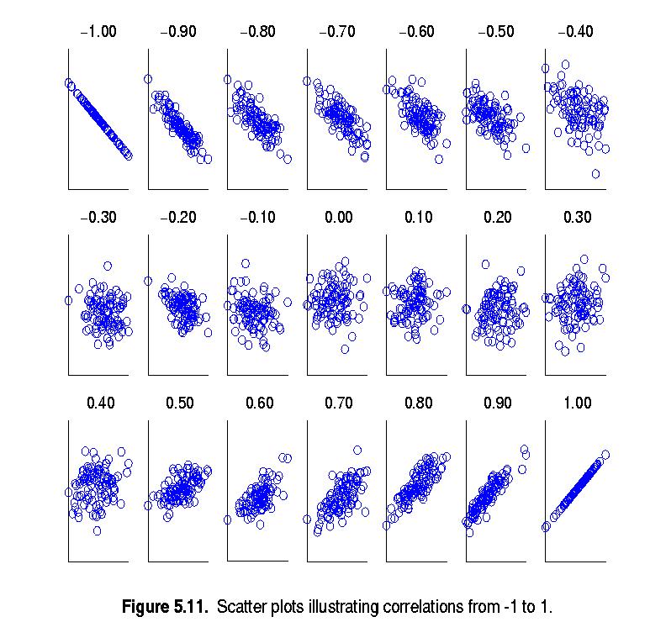
Visually Evaluating Correlation
Scatter plots showing the similarity from –1 to 1.

Slide 9
Correlation (viewed as linear relationship)
Correlation measures the linear relationship between objects
To compute correlation, we standardize data objects, A and B, and then take their dot product

Slide 10
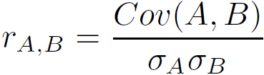
Covariance (Numeric Data)
Covariance is similar to correlation
where n is the number of tuples, and are the respective mean or expected values of A and B, σ_{A} and σ_{B} are the respective standard deviation of A and B.
Positive covariance: If Cov_{A,B} > 0, then A and B both tend to be larger than their expected values.
Negative covariance: If Cov_{A,B} < 0 then if A is larger than its expected value, B is likely to be smaller than its expected value.
Independence: Cov_{A,B} = 0 but the converse is not true:
Some pairs of random variables may have a covariance of 0 but are not independent. Only under some additional assumptions (e.g., the data follow multivariate normal distributions) does a covariance of 0 imply independence
Correlation coefficient:

Slide 11

Co-Variance: An Example
It can be simplified in computation as
Suppose two stocks A and B have the following values in one week: (2, 5), (3, 8), (5, 10), (4, 11), (6, 14).
Question: If the stocks are affected by the same industry trends, will their prices rise or fall together?
E(A) = (2 + 3 + 5 + 4 + 6)/ 5 = 20/5 = 4
E(B) = (5 + 8 + 10 + 11 + 14) /5 = 48/5 = 9.6
Cov(A,B) = (2×5+3×8+5×10+4×11+6×14)/5 − 4 × 9.6 = 4
Thus, A and B rise together since Cov(A, B) > 0.

Slide 12
Homework
How to Handle Redundancy in Data Integration ?
Discuss chi square test.

Slide 13
References
TEXT BOOKS
Introduction to Data Mining, Tan, Steinbach and Vipin Kumar, Pearson Education, 2016
REFERENCE BOOKS
Data Mining: Concepts and Techniques, Pei, Han and Kamber, Elsevier
Journals:
http://www.ijsmsjournal.org/ijsms-v4i4p137.html
https://www.springer.com/journal/41060

Slide 14
Thank you
Please Send Your Queries on:
e-Mail: neha.e11231@cumail.in

